Slide 1



CAR RENT ALMATY

Slide 2



OUR TEAM
Almabayev Assanali
Altybayev Alikhan
Asanbekova Merim

Slide 3
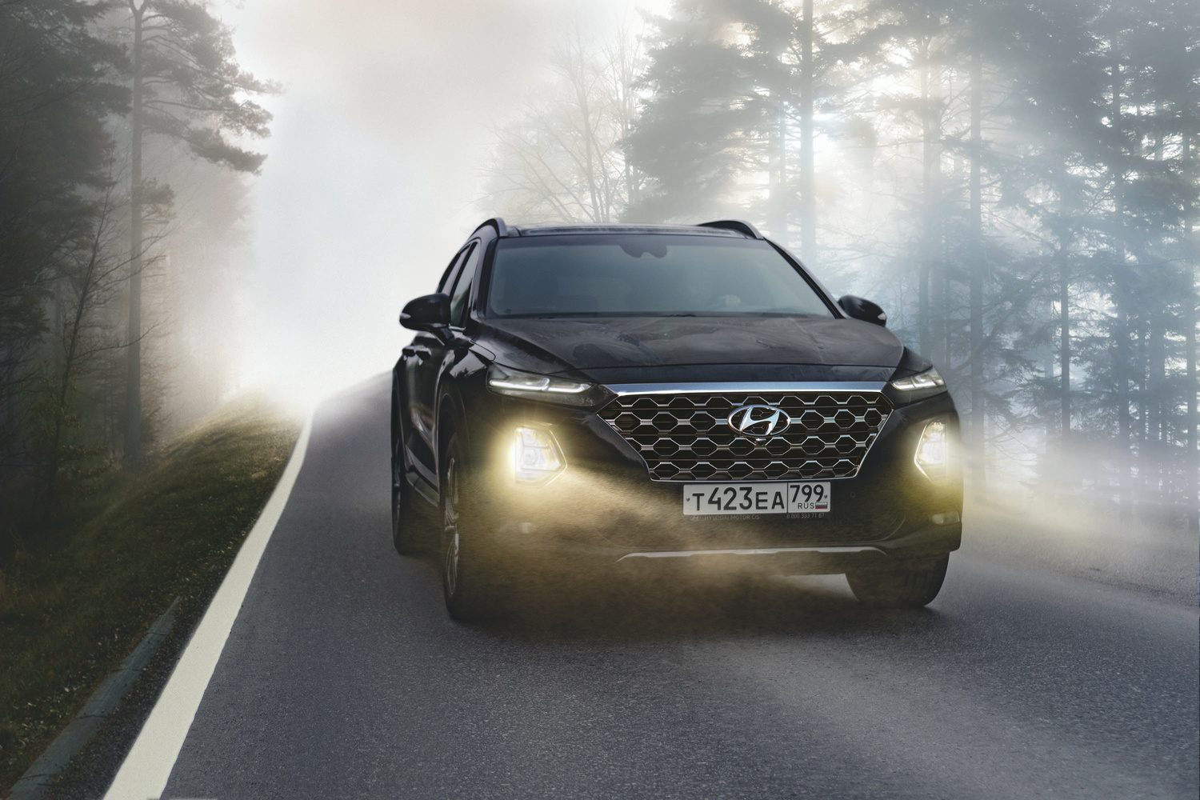
INTRODUCTION
There are few websites that can attract users with their convenience, simplicity, and functionality. This has led to a growing demand for online car rental services among tourists and local residents

Slide 4

OUR
SOLUTION
We built an appealing and simple website where, with just a few clicks, any resident or tourist in Almaty can rent a car. One of the website features is a responsive design, making it accessible on both computers and smartphones

Slide 5
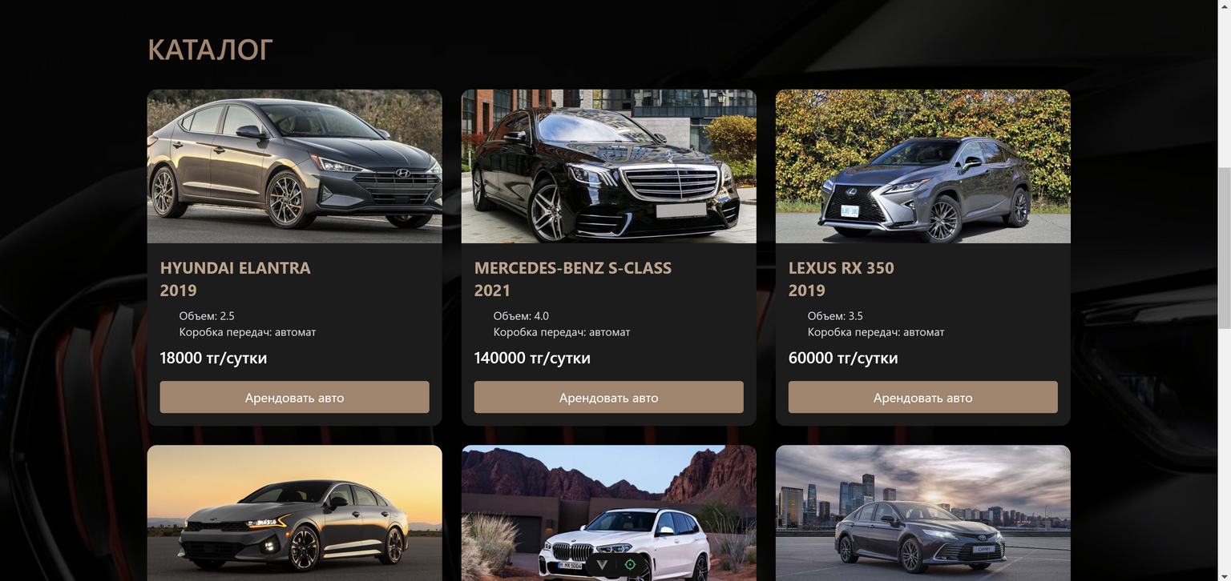
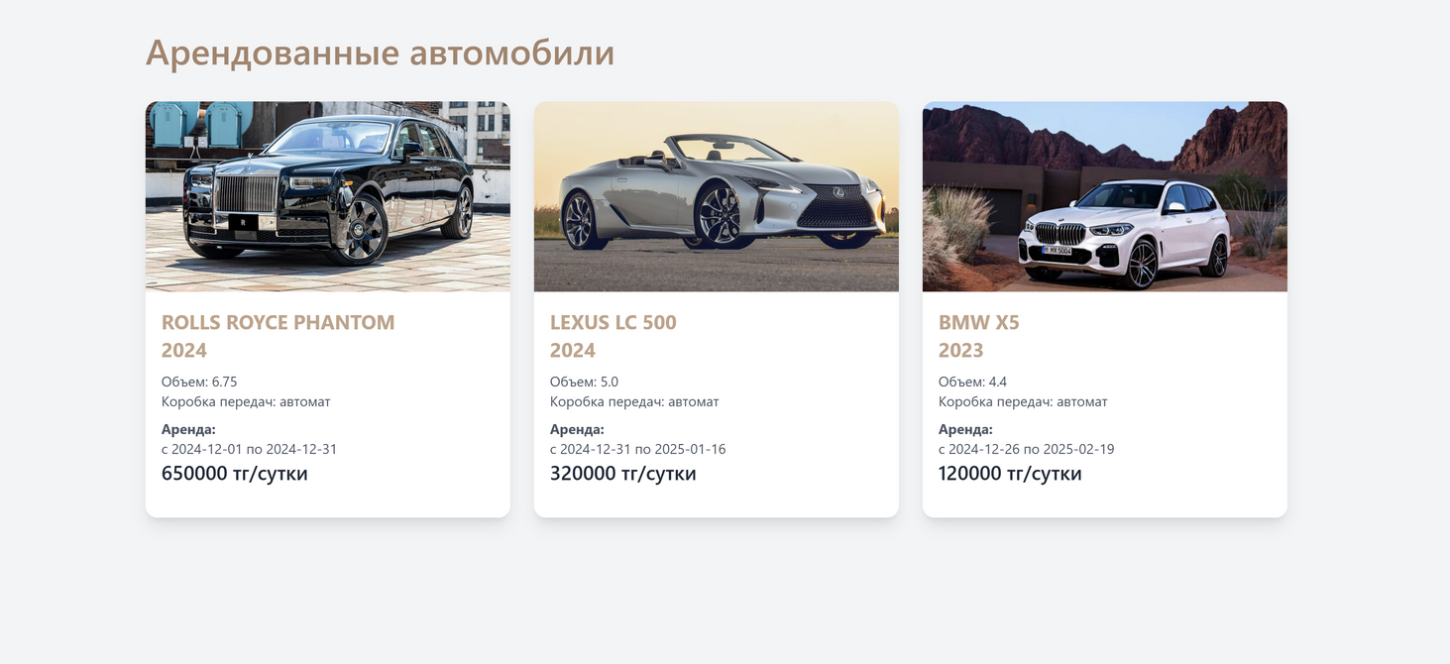
DEMO
Here you can find the main sections of our website where users can rent and view their already rented cars.

Slide 6
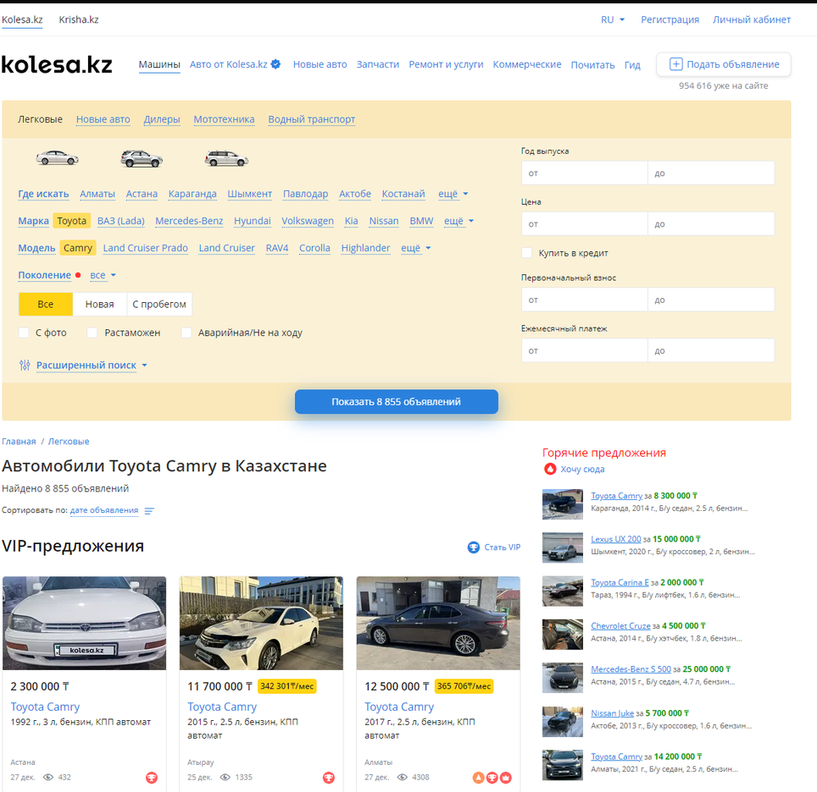
TECHNICAL APPROACH
We analyzed current trends and provided recommendations to simplify the service delivery process. For the development, we used several tools, including HTML, JavaScript, Vue.js, and its libraries, to create a dynamic and user-friendly interface.

Slide 7
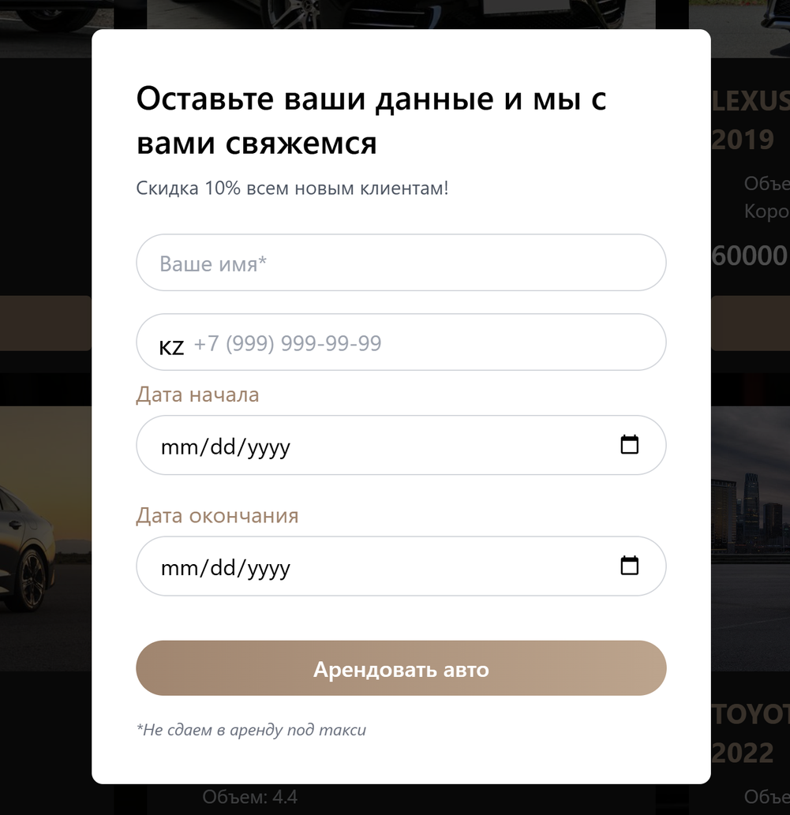
CHALLENGES
After testing the website, we discussed and identified the following shortcomings:
The absence of an input mask for phone numbers affects ease of use when entering the data.
Validation: This feature can help users secure their accounts by implementing measures such as requiring complex passwords, properly formatted phone numbers, and more.

Slide 8
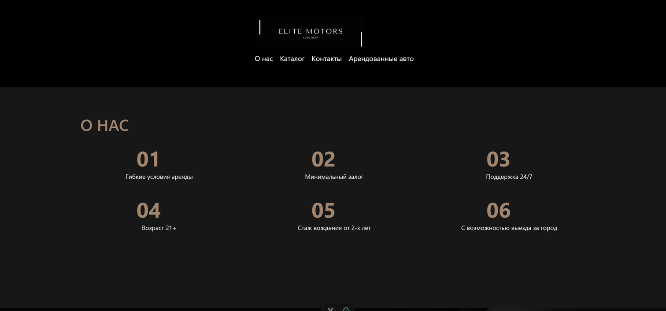
IMPACT
We have taken significant steps toward achieving this goal by creating a simple and user-friendly website where users can rent a car in just a few clicks.

Slide 9

THANK YOU

